Slide 1
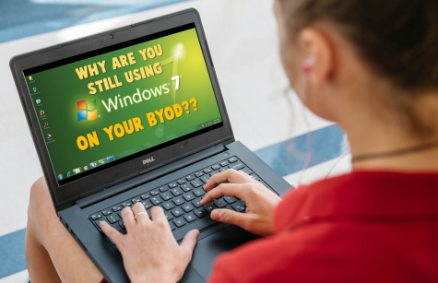
Windows 7
Student BYOD
With Microsoft ending support for Win 7 operating system within 2 months, it's essential that all remaining devices be updated or disconnected as soon as possible.
What about students in schools who "bring their own" computer that's still running
Windows 7?
It's just as important that all BYODs are updated!
Students are entitled to a FREE Windows 10 upgrade
The department's work-at-home agreement with Microsoft provides them
with Windows 10 Education for their personal device. Please advise ANY
students still using Windows 7 that they need to upgrade. Their work-at-home
software licence is available from: https://T4L.link/win10student

